Slide 1

ABHISHEK
NAGAR
DATA ANALYST PROJECT
Power BI

Slide 2

Introduction
Myself Abhishek Nagar, Data Analyst. I’m from Kota, Rajasthan.
Developed my analytical skills through various platforms. I have done virtual
internships to understand the working nature as data analyst.
Working on different public domain datasets to accommodate the
working experience.

Slide 3

About the Project
Green Destination is well known travel agency.
HR Director noticed increase in employee attrition.
We need to find trends and patterns from data provided by company.

Slide 4
Our Objective and Vision
Objective
Rate of Attrition
Insights and functions we need to perform
Vision
Factors like age, no. of years at company & monthly income plays role in Attrition.

Slide 5

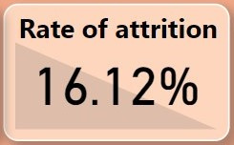
Rate of Attrition
ATTRITION
Total Employees
1470
No. of Attrition
237

Slide 6

RATE OF ATTRITION
18 to 21
by AGE: top 3 age groups
18 TO 21
21 to 25
53.66%
21 TO 25
25 to 29
26.83%
25 TO 29
23.15%

Slide 7
ATTRITION RATE
By Monthly Salary
1k to
4k
4k to 8k
8k to 12k
12k to 16k
16k to 20k
16k to 20k
25.23%
10.99%
15.59%
8.70%
3.97%

Slide 8

0-5yrs : 20.88%
ATTRITION RATE
5-10yrs : 12.28%
10-15yrs : 6.48%
15-20yrs : 6.94%
by No. of Years at Company
20-25yrs : 9.76%
25-30yrs : 100%
30-35yrs : 25%
35-40yrs : 25%

Slide 9
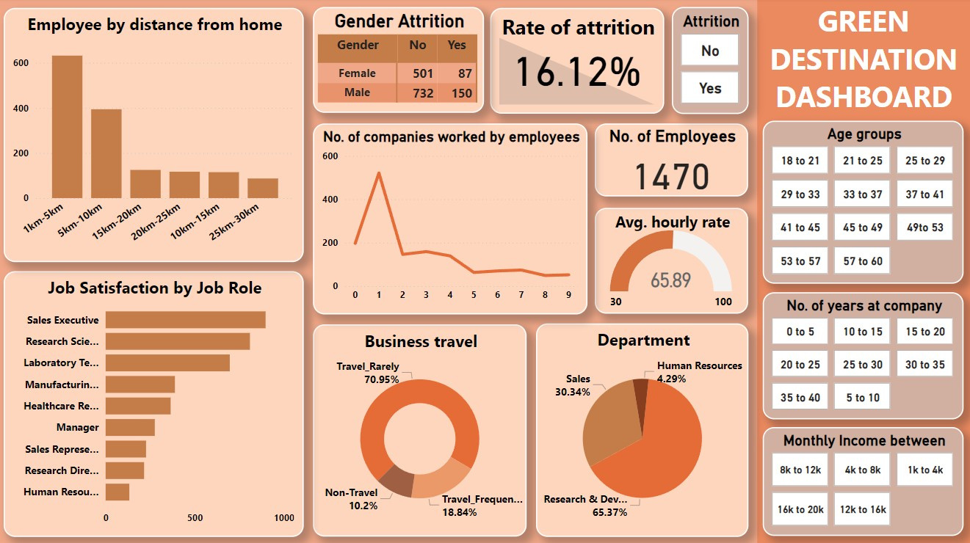
Dashboard on Power BI

Slide 10



Thank you
Email
abhiiinagar7@gmail.com
LInkedIn
www.linkedin.com/in/abhishek-nagar-8749a024b
Contact
+91 7619734902

